Slide 1
Unit 5
Lecture 2

Slide 2
Regenerative braking in induction motor
Regenerative braking is an inherent characteristic of an induction motor since it operates as an induction generator when load torque is such that it runs at speed above synchronous speed and it feeds power back to the supply which is possible in case of overhauling load.
Other ways to apply regenerative braking in induction motor operating at particular speed and constant load torque is to decrease the synchronous speed by employing any one of the following processes:
1. switching over to a low frequency supply.
2. switching over to a larger pole number operation.

Slide 3
Regenerative braking in induction motor(contd)
In all of the above processes the slip and torque developed becomes negative and thus the machine runs as generator .
If the load drives the motor above synchronous speed in case of overhauling load no switching operation is required and the braking operation automatically starts.
The operating point will depend upon the magnitude of load torque and the nature of torque speed characteristic of machine during generating operation.
By varying the rotor resistance in rotor circuit it is possible to operate at any speed above synchronous speed during braking
In case the driving torque of load exceeds the maximum braking torque of which the machine is capable of the system becomes unstable and the speed will rise further probably to a disastrous value since the faster the machine runs lesser will be the braking torque developed

Slide 4
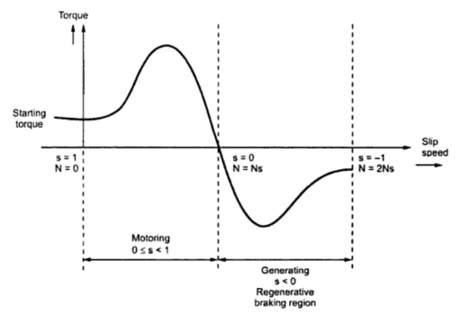

Slide 5
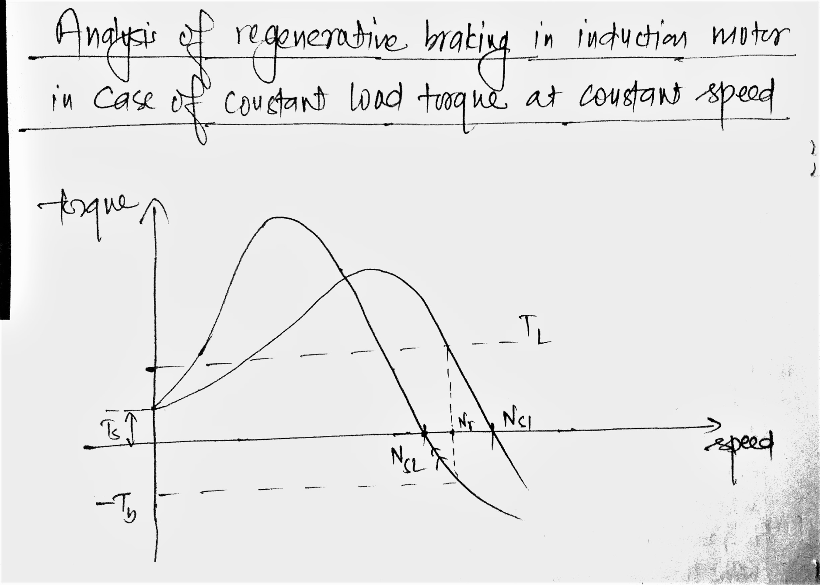

Slide 6
Braking of synchronous motor
Only dynamic braking can be applied.
Plugging cannot be applied because if the supply is reversed then stator field is also reversed but the rotor is rotating in the same direction because of inertia. Hence the relative speed between stator field and rotor field is not zero and no torque is produced.
Plugging can be applied by providing damper winding which makes it to operate as an induction motor. But the torque produced due to this damper winding is very less so in practice it is not used.
Regenerative braking cannot be applied as it need speed greater than synchronous speed which is not possible in synchronous machine because relative speed between stator field and rotor field is not zero in that case consequently no torque is produced.

Slide 7
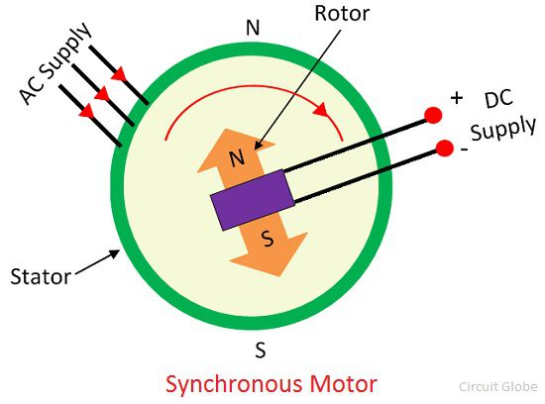

Slide 8
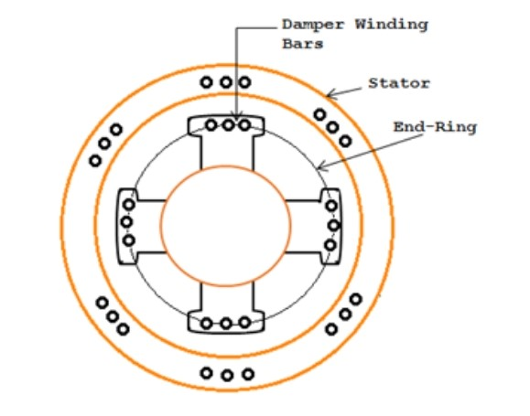

Slide 9
Dynamic braking of synchronous motor
Dynamic braking is applied by disconnecting the motor from the supply and reconnecting the motor across three phase resistor keeping the field excitation constant. At this moment the motor acts as synchronous generator and energy is dissipated in the resistors.
For higher braking torque field excitation can be increased.

Slide 10
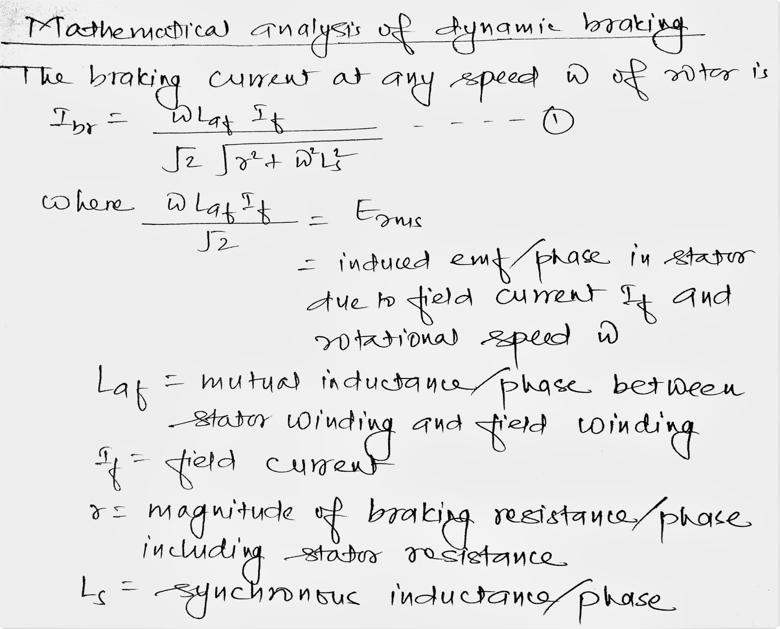

Slide 11
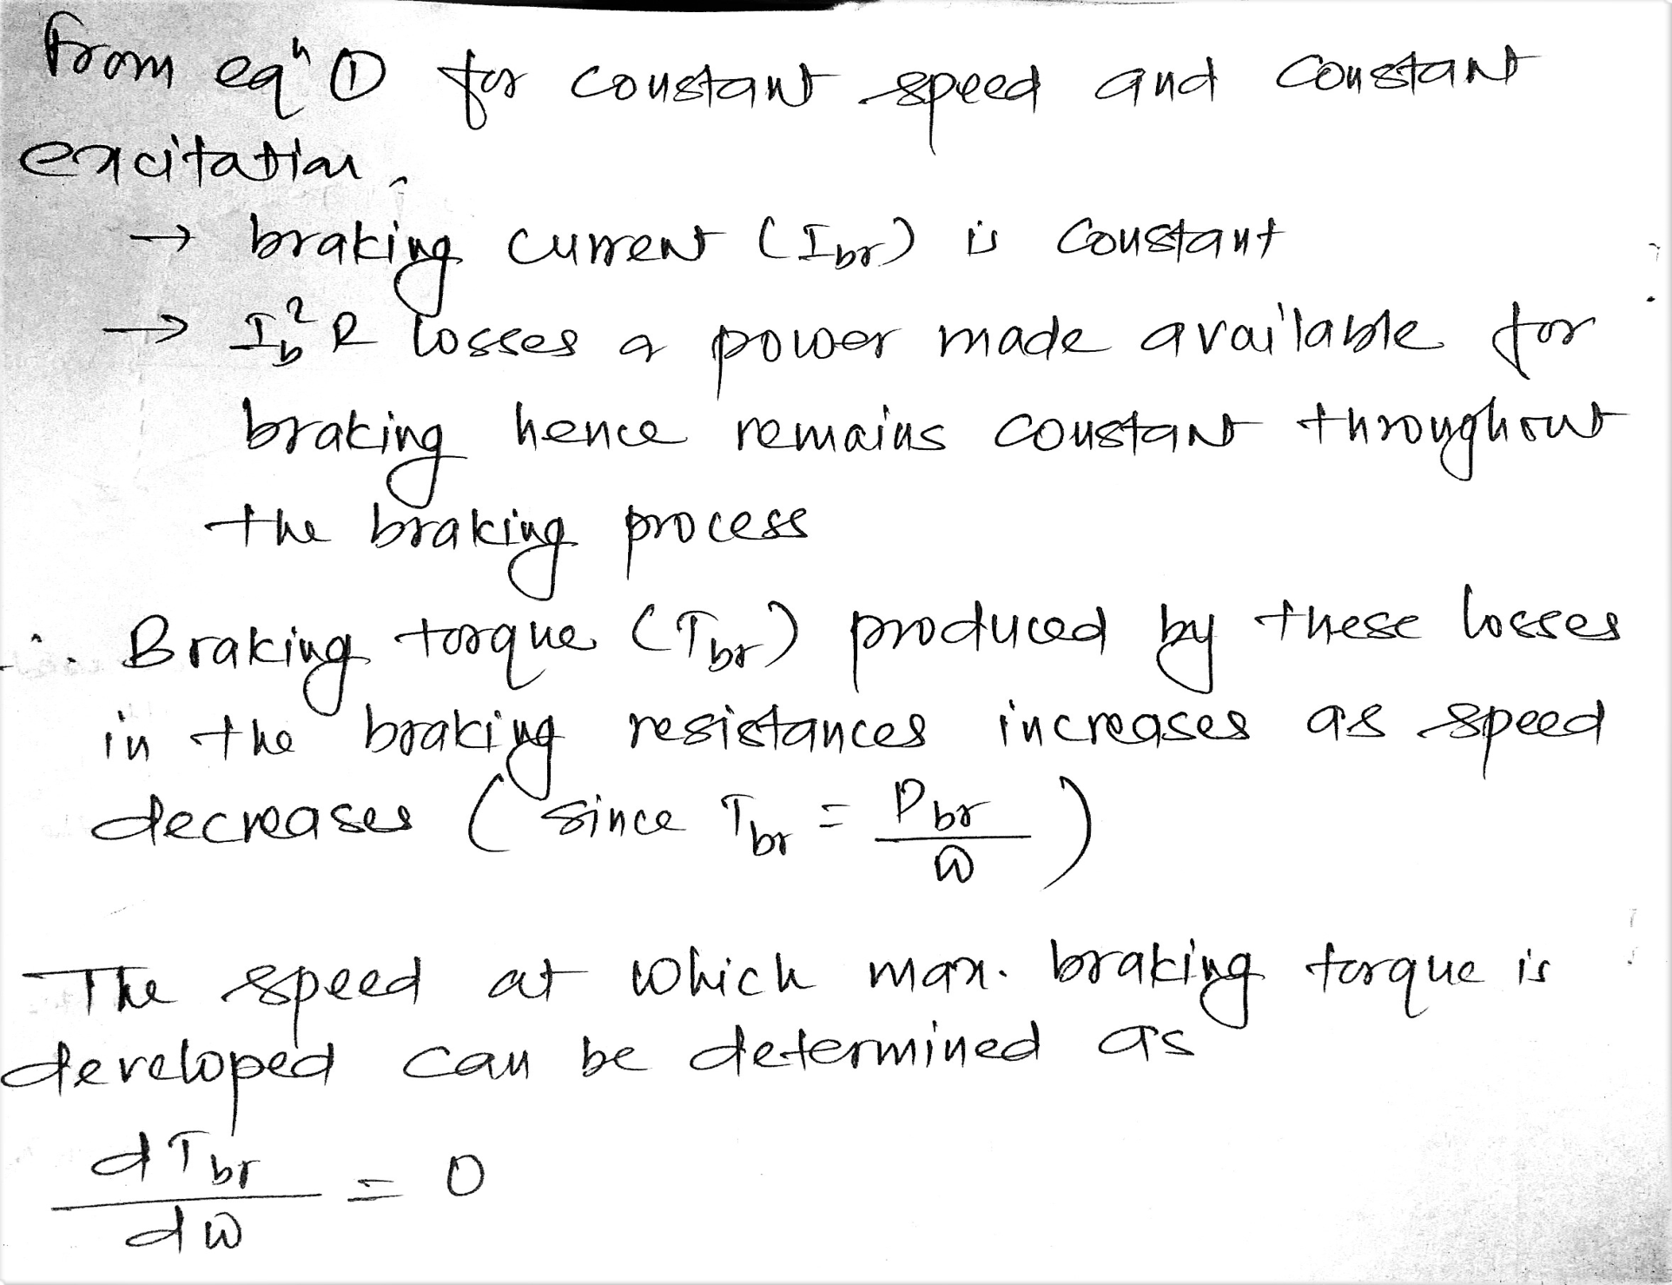

Slide 12
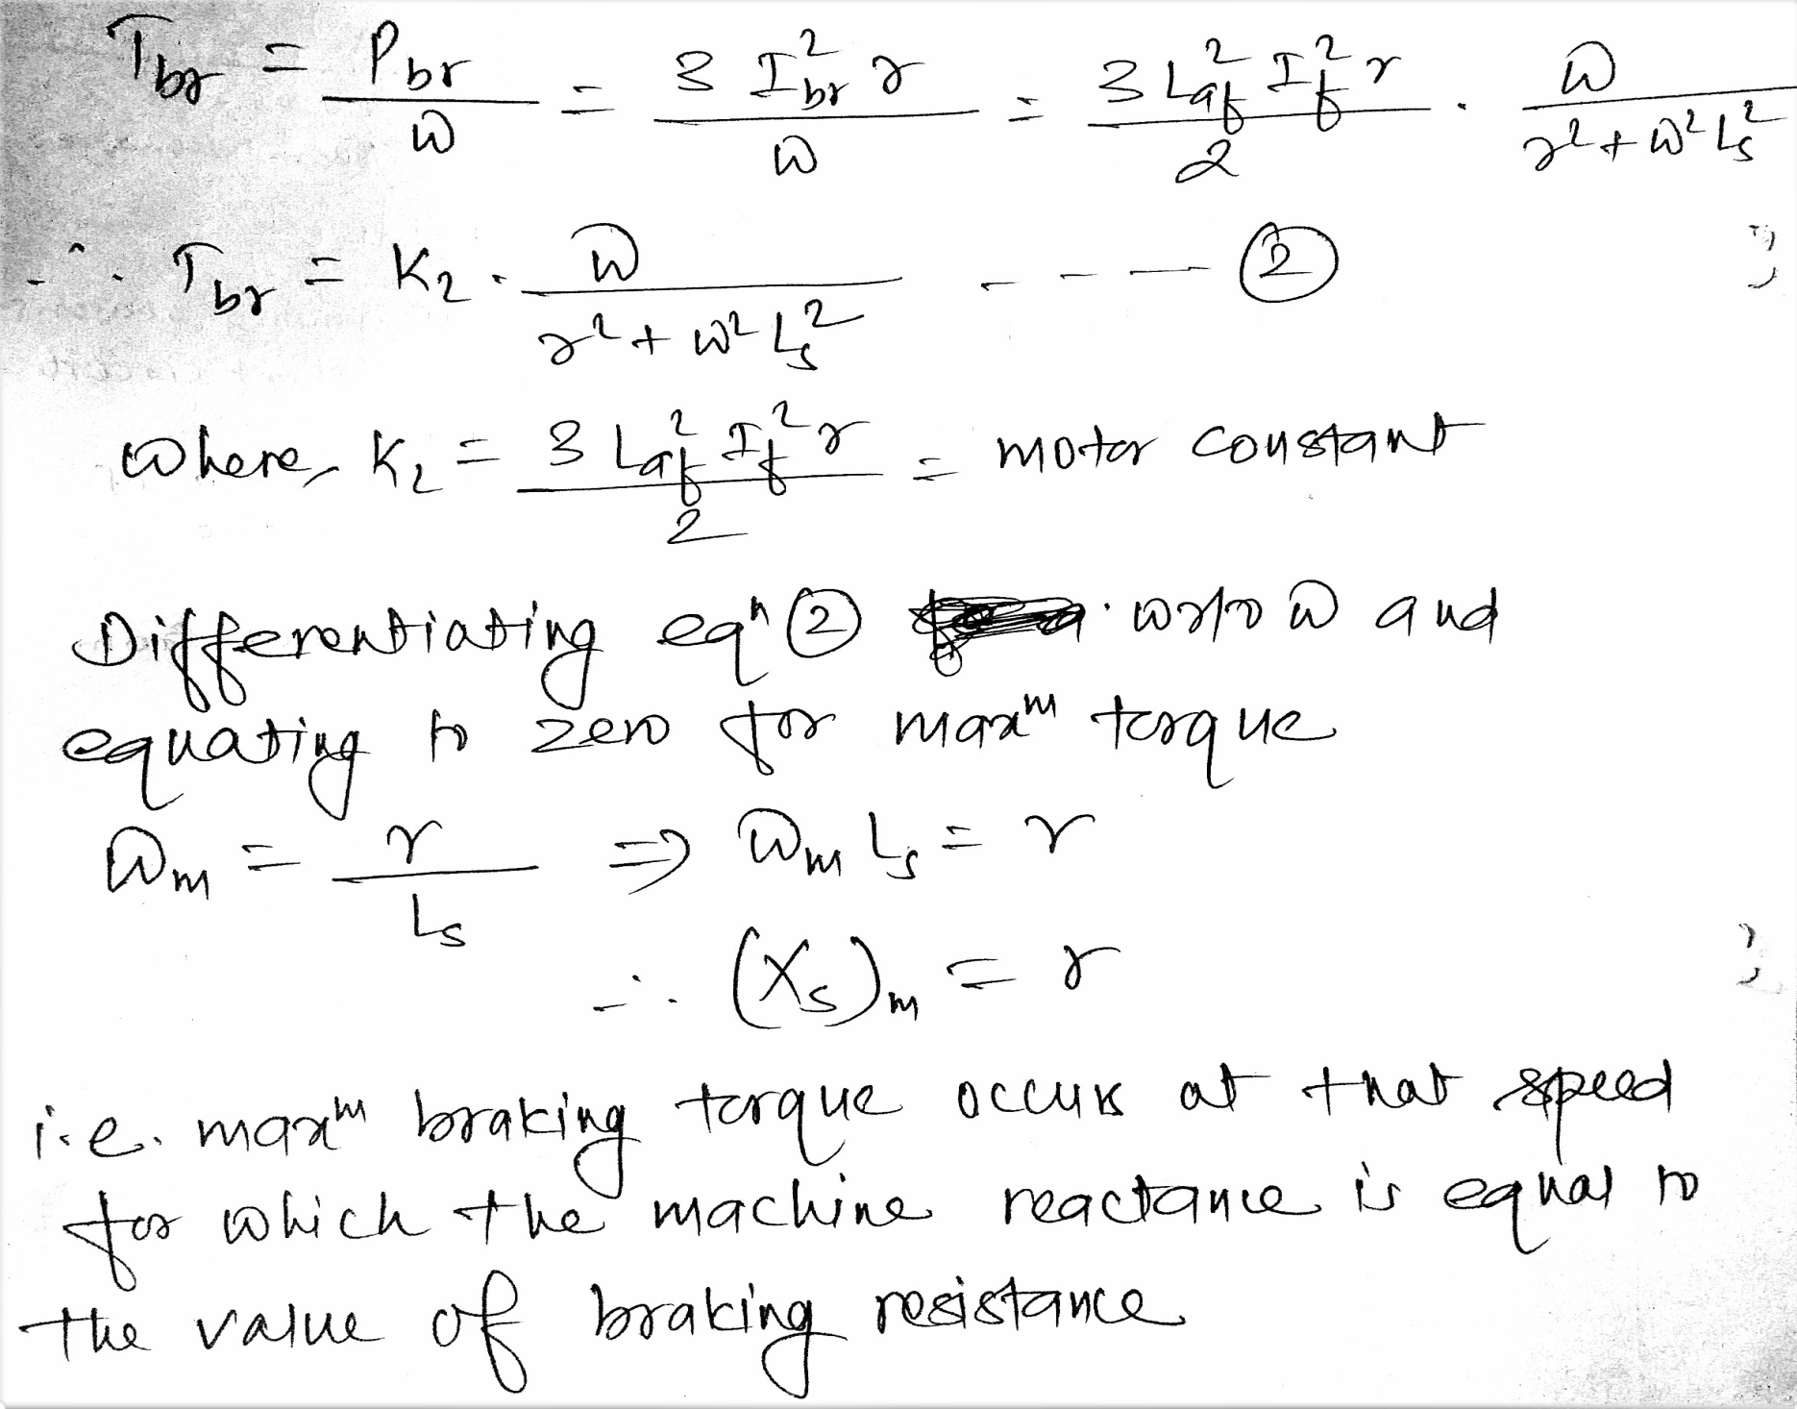

Slide 13
Plugging in dc shunt motor

